Slide 1
REDESIGN OF TURF TOWN
211701004 - AJAY KRISHNA C R
211701009 - JASWANTH REDDY B

Slide 2
Problem Statement
Turf Town, a sports management application focused on organizing and scheduling turf-based sports activities, is currently facing usability challenges that hinder its user experience. The app aims to connect sports enthusiasts with available turf facilities for seamless booking and coordination. However, user feedback and analytics indicate several pain points that need to be addressed to enhance the overall UI/UX. The key problems identified are:
Complex Navigation:
Users find it challenging to navigate through the app efficiently, resulting in a cumbersome booking process.
Information architecture needs improvement to ensure a logical flow and intuitive journey for users from exploring turf options to confirming bookings.
Inconsistent Visual Design:
Users may find it difficult to establish a visual hierarchy and may experience confusion in locating essential elements, such as booking options, facility details, and payment features.
Inefficient Booking Process:
The booking process is lengthy and involves multiple steps, discouraging users from completing transactions.

Slide 3
Objectives
Simplify the app's navigation by restructuring the information architecture to create a more intuitive flow from exploring turf options to completing bookings.
Simplify and streamline the booking process by reducing the number of steps required to make a reservation.
Our goal is to identify the key pain points of the app users and create solutions that address these challenges, with the ultimate aim of enhancing the app’s usability, functionality, and accessibility for potential users.

Slide 4
Literature Survey 0n Existing Models/ Animated Videos (Design)
S.No. | Proposed Year/ No.of Viewers/Reachability | Design Principles/Visual Elements proposed | Limitations / Areas of Improvement required
1. | Application proposed in the year (2019) | (Roboto and San serif ) font family | *Lack of visual hierarchy results in overlooking. *Visual clutter makes it difficult to comprehend important information

Slide 5
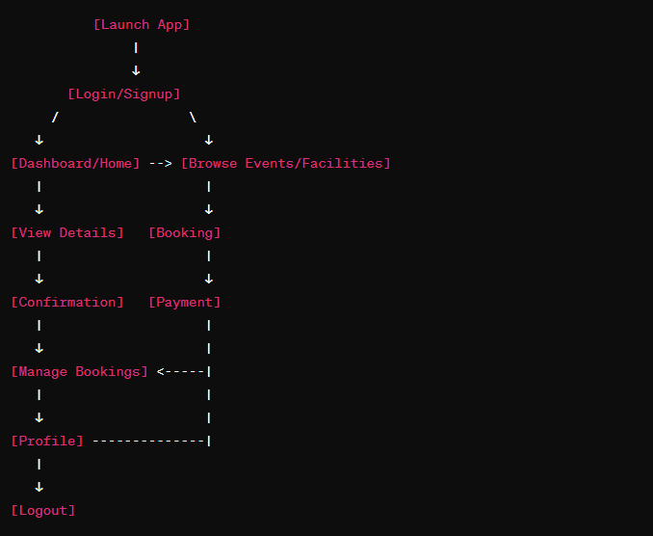
Schematic Diagram

Slide 6
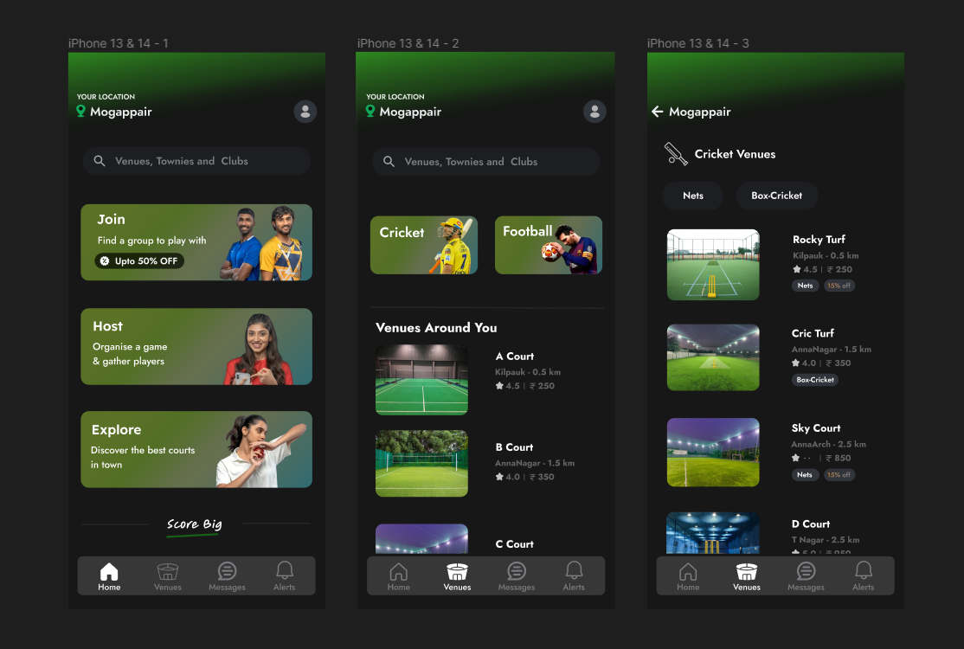
Output Images

Slide 7
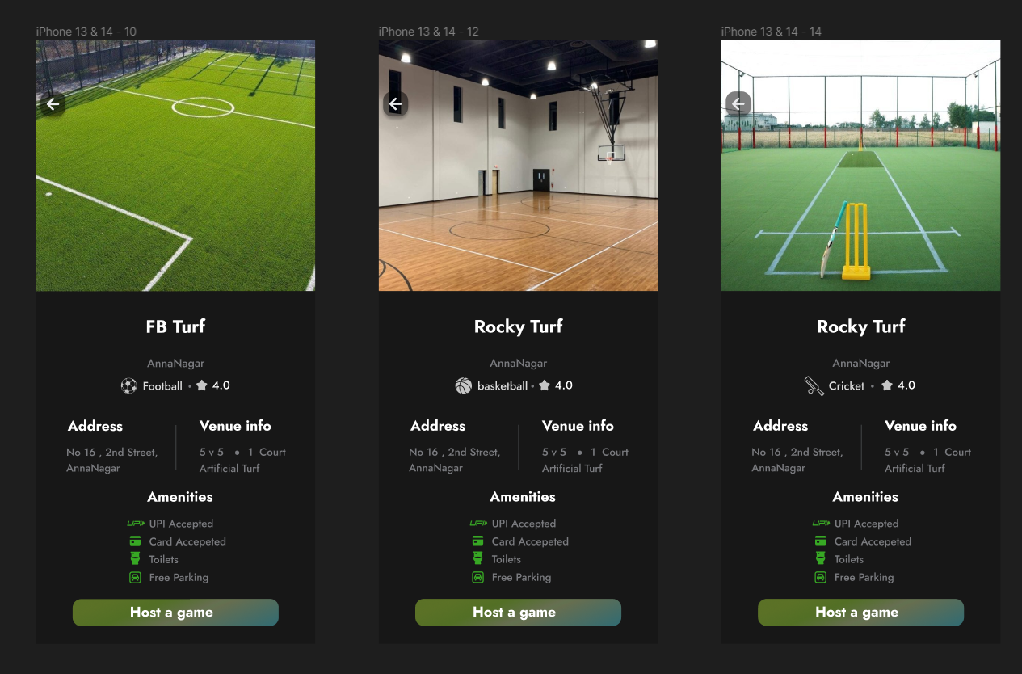
Output Images

Slide 8
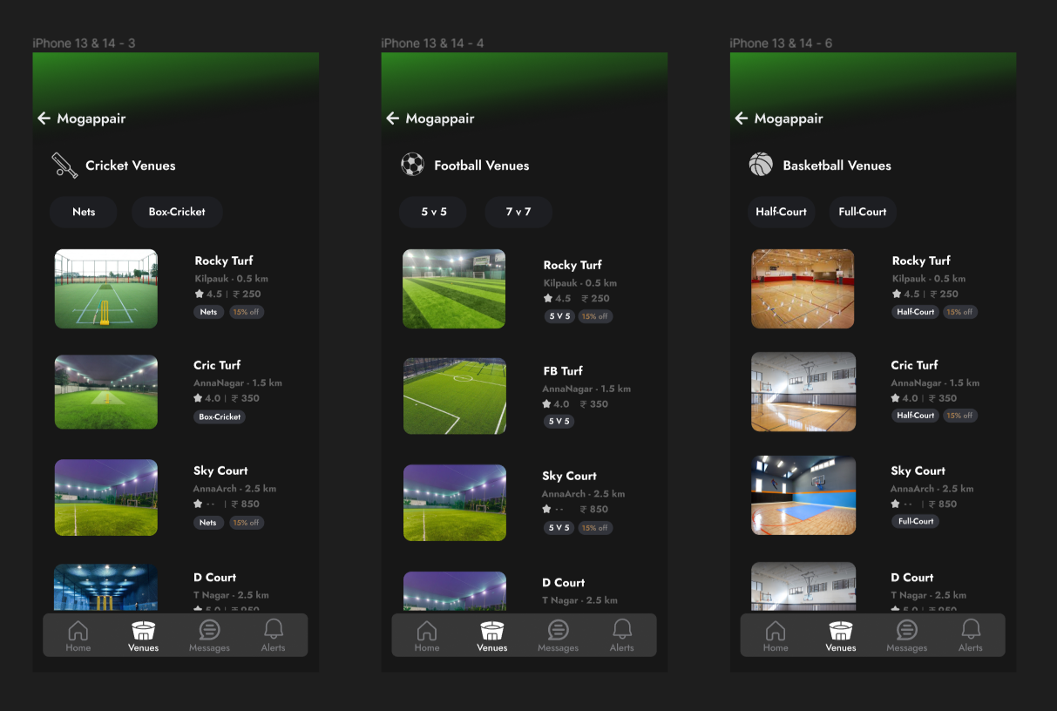
Output Images

Slide 9
Survey Summary
Navigation Challenges: A significant number of respondents reported difficulties in navigating through the app. Users expressed frustration with the current information architecture, finding it challenging to move seamlessly from browsing turf options to completing bookings.
Booking Process Complexity: Users cited a lengthy and complicated booking process as a major pain point. Many respondents abandoned bookings midway due to the number of steps and unclear instructions.
Visual Inconsistency: A considerable portion of the respondents highlighted the lack of a consistent visual design, making it challenging to establish a clear visual hierarchy. Users expressed a desire for a more cohesive and visually intuitive interface.
The redesign project will prioritize restructuring the information architecture to address navigation challenges.
Streamlining the booking process will be a key focus, with an emphasis on reducing complexity and improving user guidance.
The redesign will aim to establish a visually consistent design language to enhance the overall user interface

